Slide 1

New York Airbnb Price Prediction

Slide 2
Background
Airbnb is a rental platform which offers rental properties
It provide a variety of shared and independent short-term need based options to tourists, students and business professionals.
Airbnb is trying to introduce and price its services based on the features listed for the lodging so that they can provide customized solutions on the basis of the customer’s budget and demand.

Slide 3
Data acquisition and cleaning
A well-developed dataset could be found from Kaggle dataset “New York City Airbnb Open Data” https://www.kaggle.com/dgomonov/new-york-city-airbnb-open-data
There are 48895 rows and 16 columns
Irrelevant features are dropped. 12 columns left after dropping.
Missing values in review_per_month are replaced by 0.

Slide 4
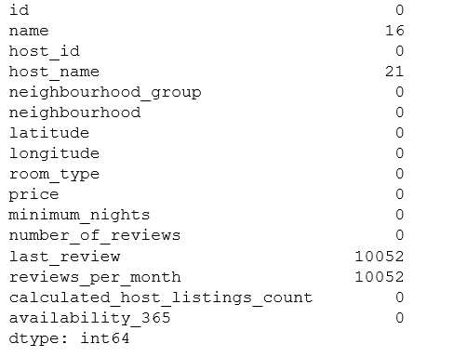
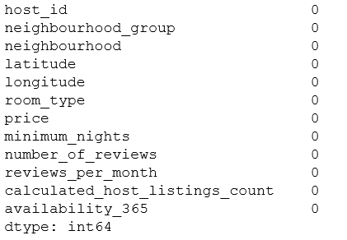
Missing values before cleaning
Missing values after cleaning

Slide 5
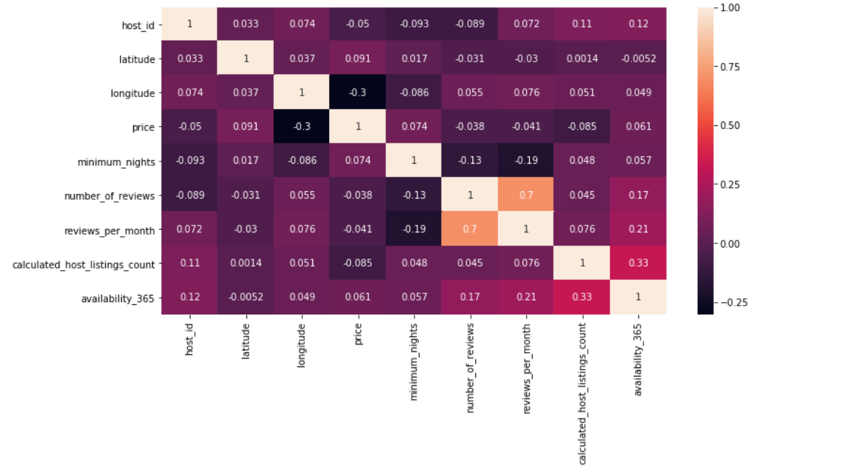
Correlation Heat Map
Correlation matrix as heatmap is used to check the correlation among different numeric variables as there are multiple columns in the dataset
Higher correlation means there are higher chances of multicollinearity

Slide 6
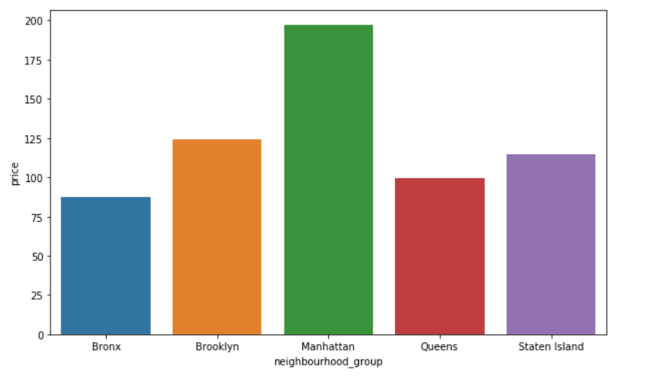
Relationships between neighbourhood and price

Slide 7
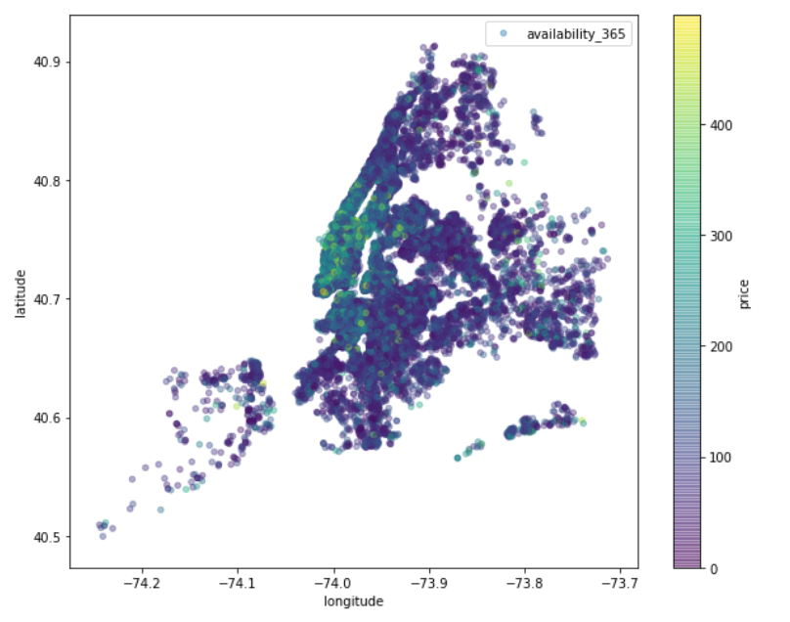
Price distribution

Slide 8
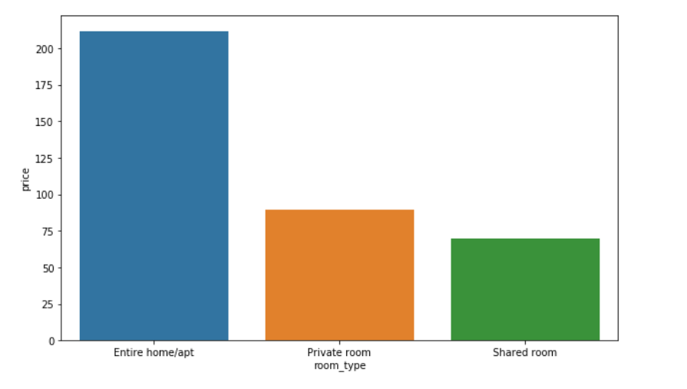
Relationship between room type and price

Slide 9
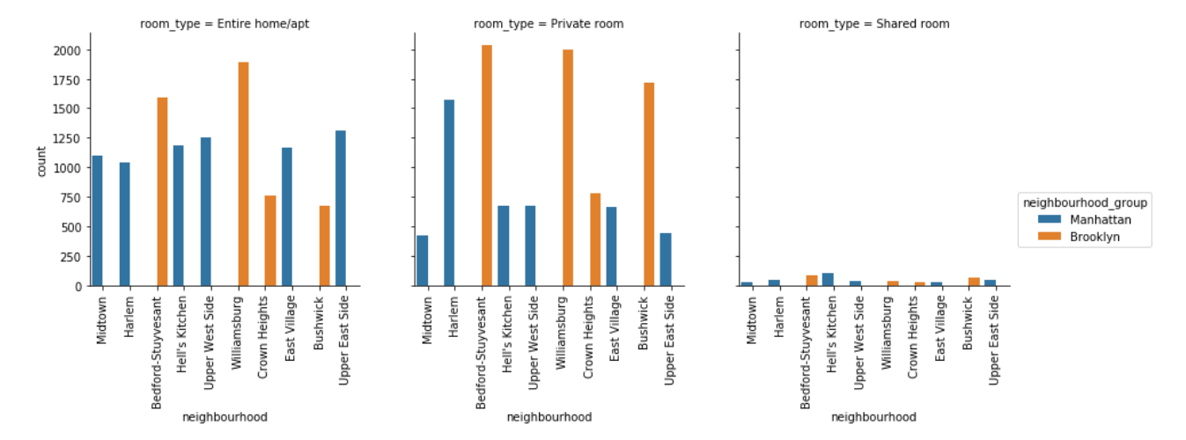
Popular room types in top 10 neighborhoods

Slide 10
Methodology
Multiple Linear Regression
Lasso
Ridge
Elastic Net
Bagging
Random Forest

Slide 11
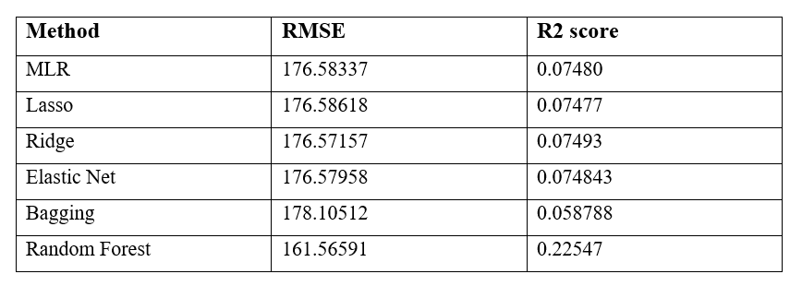
Result
Random Forest produces the lowest RMSE, indicating the best model is this analysis.

Slide 12
Discussion and conclusion
There are still many limitations that will affect the accuracy.
Firstly, there might be other models that could produce more accurate predictions.
Secondly, the price of an Airbnb property might be affected by other features, for example, the interior design.
This prediction can be helpful for people who would like to start a Airbnb business or tourists who are looking for an Airbnb.

Slide 13
Thank You

